Slide 1
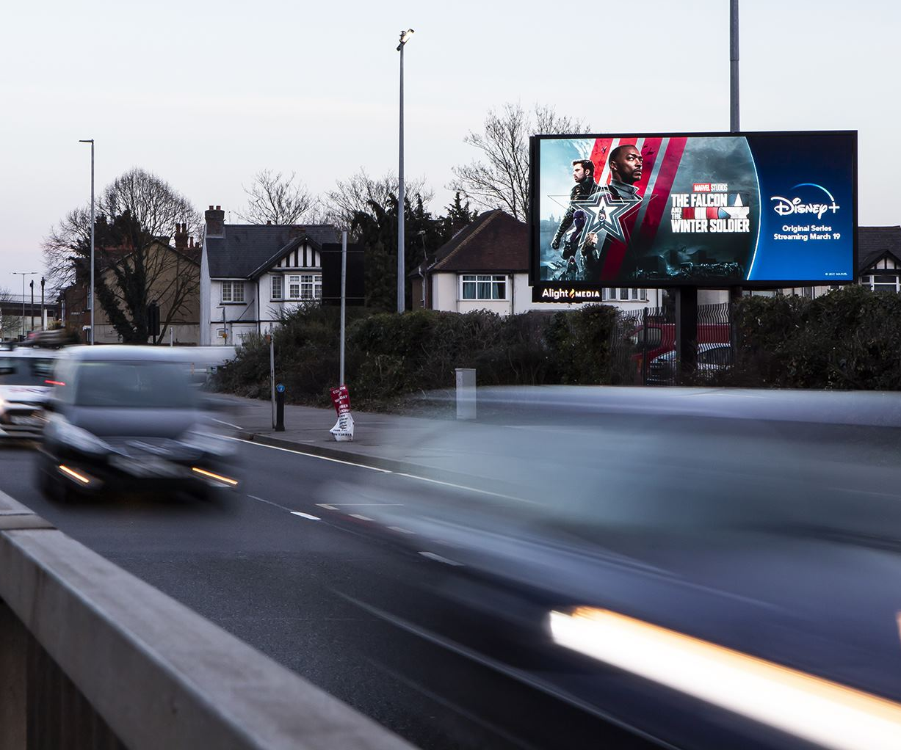
Duplicate of Page 1
Notes:
textbox
No alt text provided
map
No alt text provided
textbox
No alt text provided
textbox
No alt text provided
textbox
No alt text provided
card
No alt text provided
card
No alt text provided
card
No alt text provided
card
No alt text provided
card
No alt text provided
textbox
No alt text provided
textbox
No alt text provided

